Slide 1
Data Structure & Algorithm
Data Structure is a way of collecting and organizing data in such a way that we can perform operations on these data in an effective way.
for example : Dhoni scored 30 runs
Virat scored 40 runs
Basic types of Data Structures
1.Primitive Data Structures.
2.Abstract Data Structures

Slide 2
Abstract Data Structures
Linear Data Structure:
Linked List, Stack, Queue, Array.
Hierarchical data structures:
Tree, Heap, Trie.
Other Data Structures:
HashMap, Graph, Matrix.

Slide 3
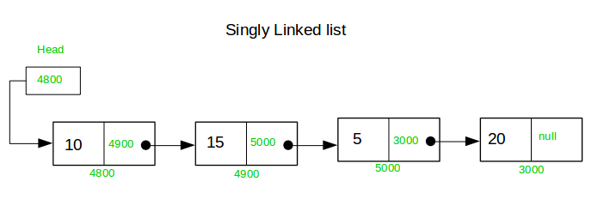
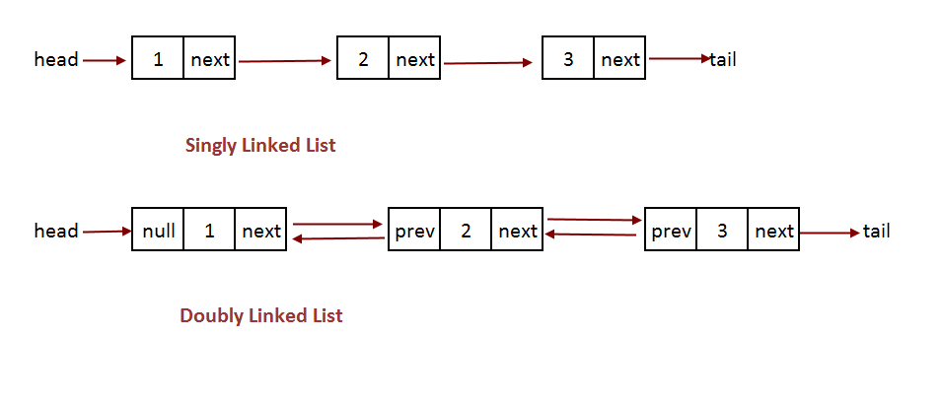
Linked List
Doubly Linked List

Slide 4
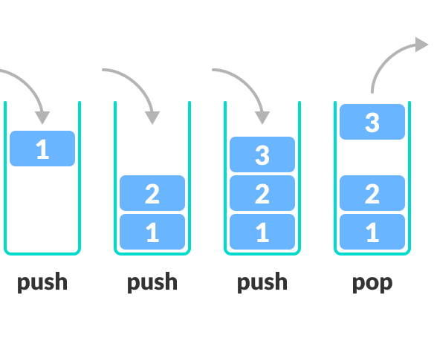

1. Stack

Slide 5

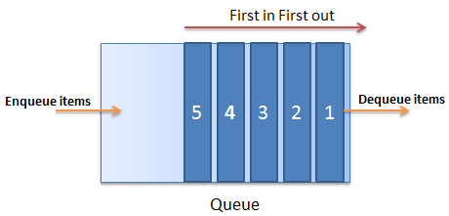
2.Queue

Slide 6

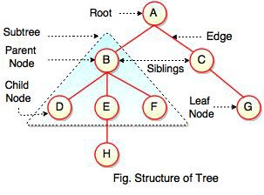
Tree

Slide 7
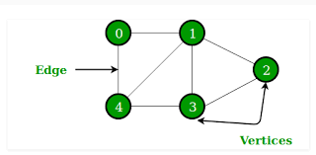
Graphs

Slide 8
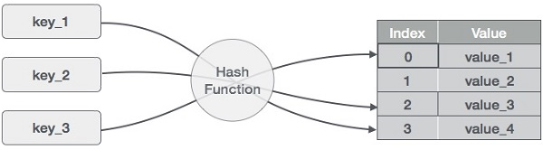
Hash Table and Heaps

Slide 9
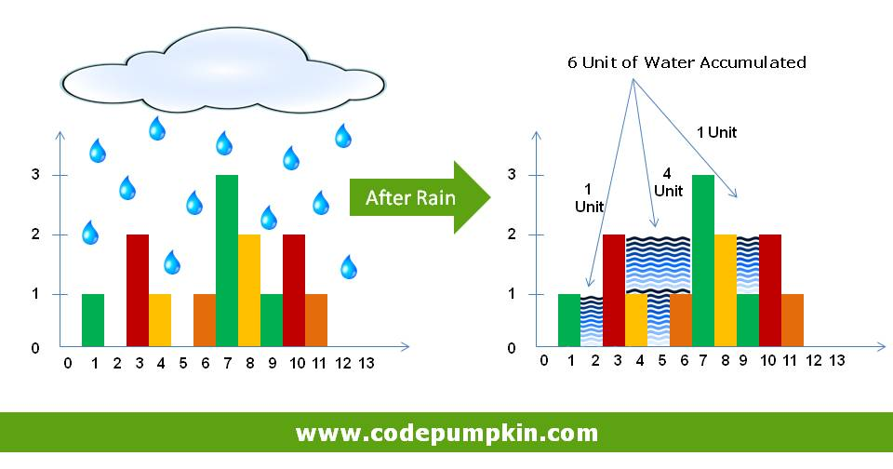
Brute Force
Rain Terraces

Slide 10
2.Recursive Staircase
3.Maximum Subarray
4.Discrete Fourier Transform

Slide 11

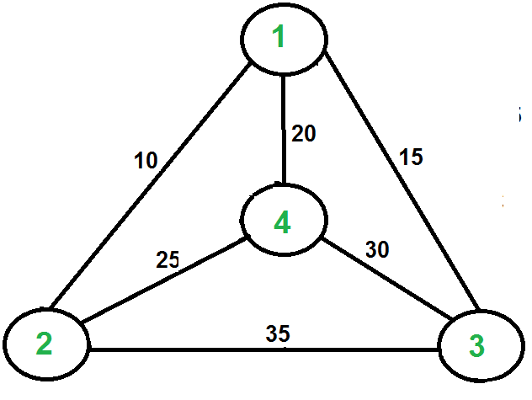
Travelling Salesman Problem

